Slide 1

Welcome to CSI-230/SYS-320
Linux/Unix Programming, Automation and Scripting
3. PowerShell Flow Control

Slide 2
Part 1 If/Else and Switches

Slide 3
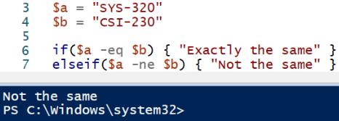
PowerShell if/else and switches
if(Boolean_expression) {
# Executes if Boolean_expression is true
}
elseif (Bloolean_expression2) {
# Executes if Boolean_expression is false, # and if Boolean_expression2 is true
}
else {
# Executes if all are false
}
-eq => checks if equal
-ne => checks if not equal

Slide 4
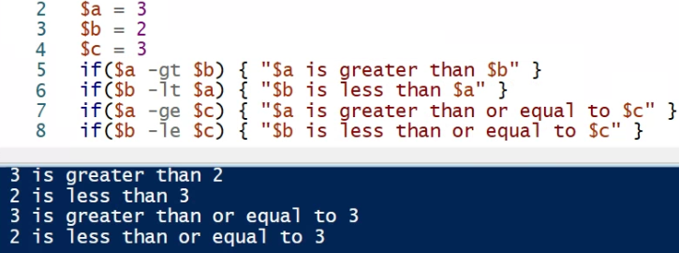
PowerShell if/else and switches
-gt => greater than
-lt => less than
-ge => greater than or equal to
-le => less than or equal to

Slide 5
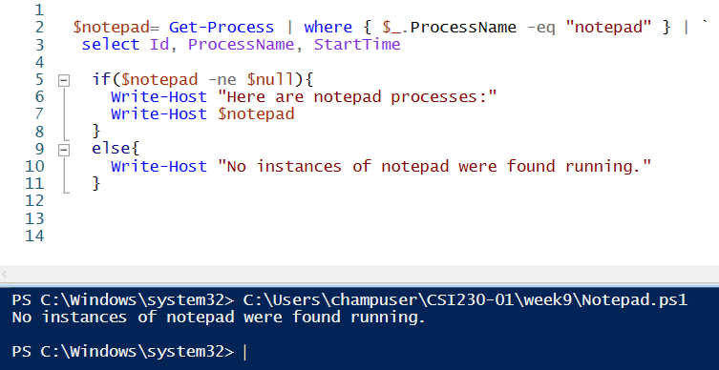
PowerShell checking empty/null

Slide 6
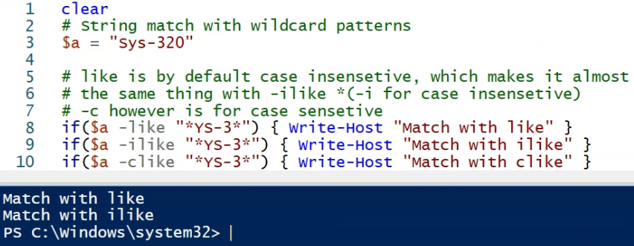
String Comparisons with -like

Slide 7
Wildcard Characters
* - Match zero or more characters
a* matches aA, ag, and Apple
a* doesn't match banana
? - Match one character in that position
?n matches an, in, and on
?n doesn't match ran
`* - Match any character as a literal (not a wildcard character)
12`*4 matches 12*4
12`*4 doesn't match 1234

Slide 8
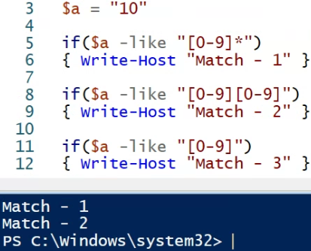
Wildcard Characters
[ ] - Match a range of characters
[a-l]ook matches book, cook, and look
[a-l]ook doesn't match took
[ ] - Match specific characters
[bc]ook matches book and cook
[bc]ook doesn't match hook

Slide 9
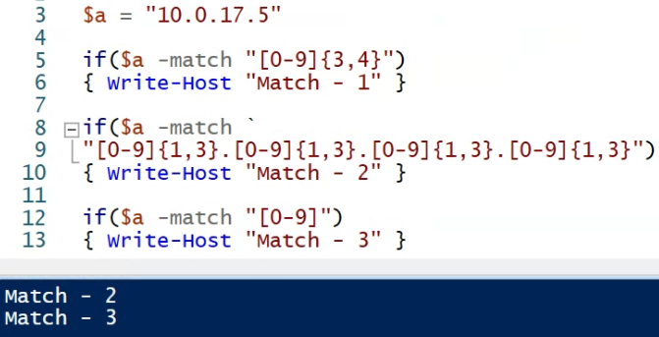
Regex & -match
-match checks if string contains regex:
'book' -match 'oo’ => returns true

Slide 10
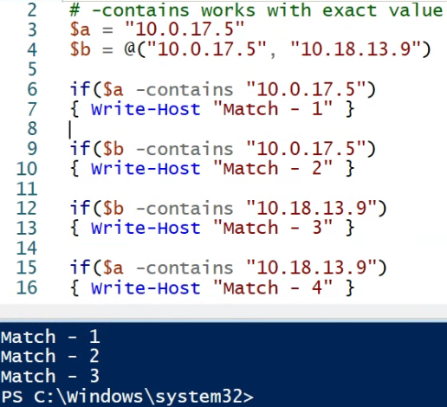
-contains
-contains checks if a value is in a collection

Slide 11
Part 2 Arrays

Slide 12
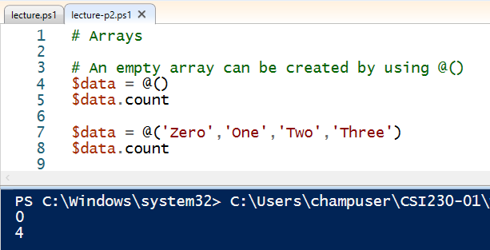
Array Initialization and Count
@ sign is used to define arrays and collections
Count gives number of elements

Slide 13
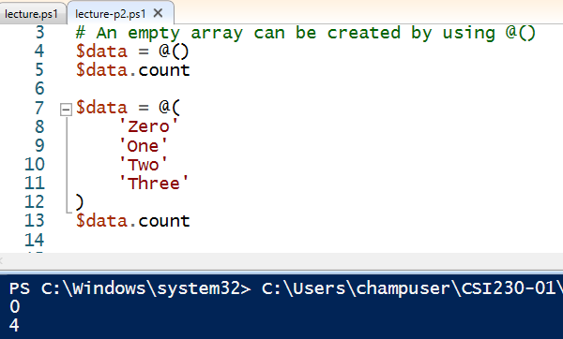
Array Initialization and Count
Multiple lines work

Slide 14
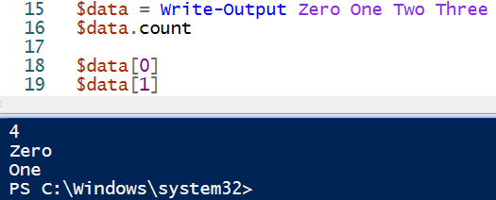
Array Access
Strings are arrays and can be defined with Write-Output
Access to elements

Slide 15
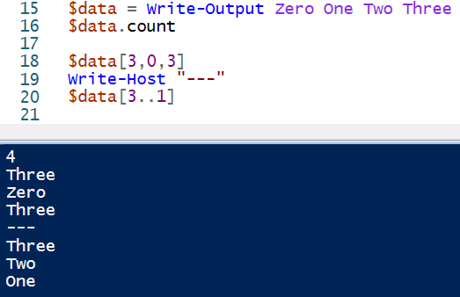
Array Access
Different ways of access

Slide 16
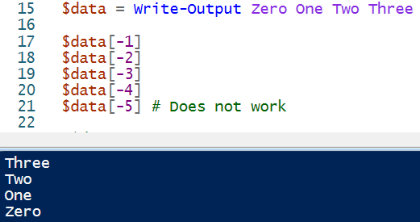
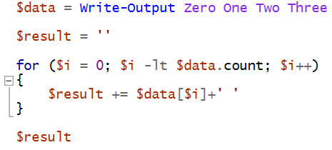


Array Access
1
2
3

Slide 17
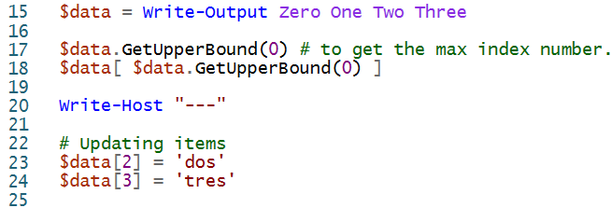
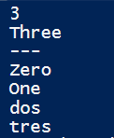
Array Access and Update

Slide 18
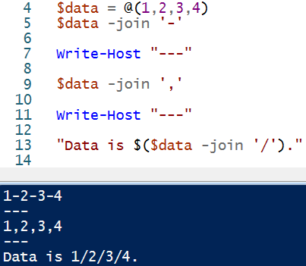
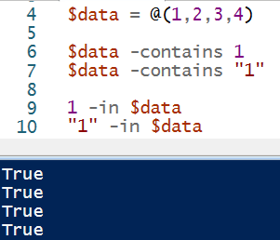
Array –join, -contains, -in
1
2
3

Slide 19
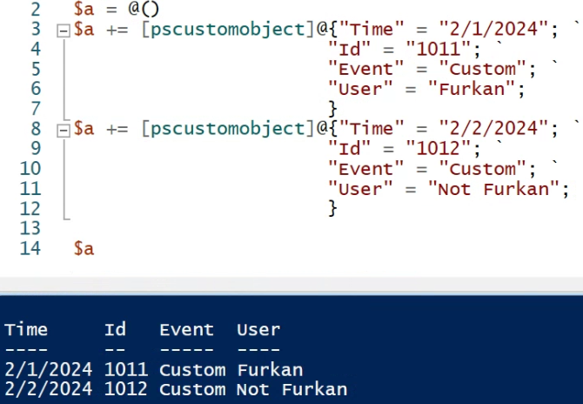
[pscustomobject]

Slide 20
Part 3 Functions

Slide 21
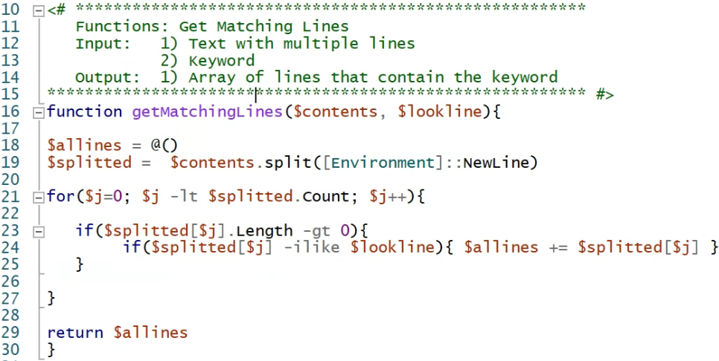
Function Definition

Slide 22
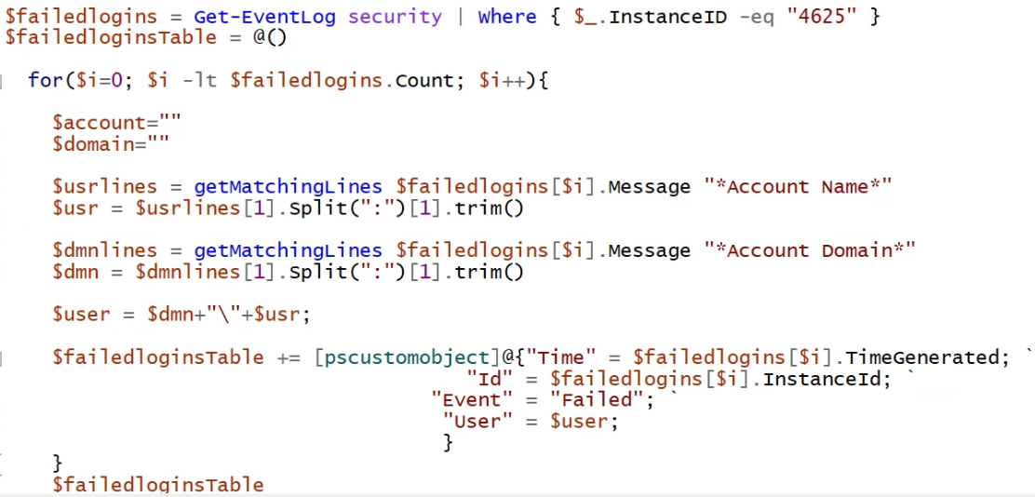
Function Call
1
2
3

Slide 23
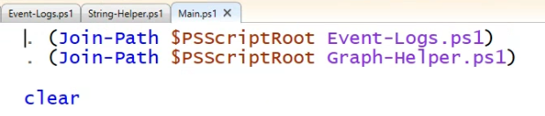
Dot notation
Helps call functions from other script files
After dot notation, the functions in the other script files can be used in the current script file.

Slide 24
Class Activities Today
Functions and Event Logs

